Slide 1

AmTrust Financial Services, Inc.
Javendean Naipul
Capstone Project
RM790
Notes:
Good evening everyone, hope you are all doing well and are looking forward to graduation! Without further a due, I will begin my presentation – if that’s okay with you, Dr. Marshal.

Slide 2
Content
Primary Line of Business
Geographic Distribution
Operational Risk Profile
Company Credit Risk Profile
SCR composition
Moody’s Scenario Analysis
Invested Asset Portfolio
Notes:
In this presentation, I will be detailing the Operational and Investment activity of AmTrust Financial Services Inc. – first describing their Business Strategy, and then their Investment Portfolio.

Slide 3
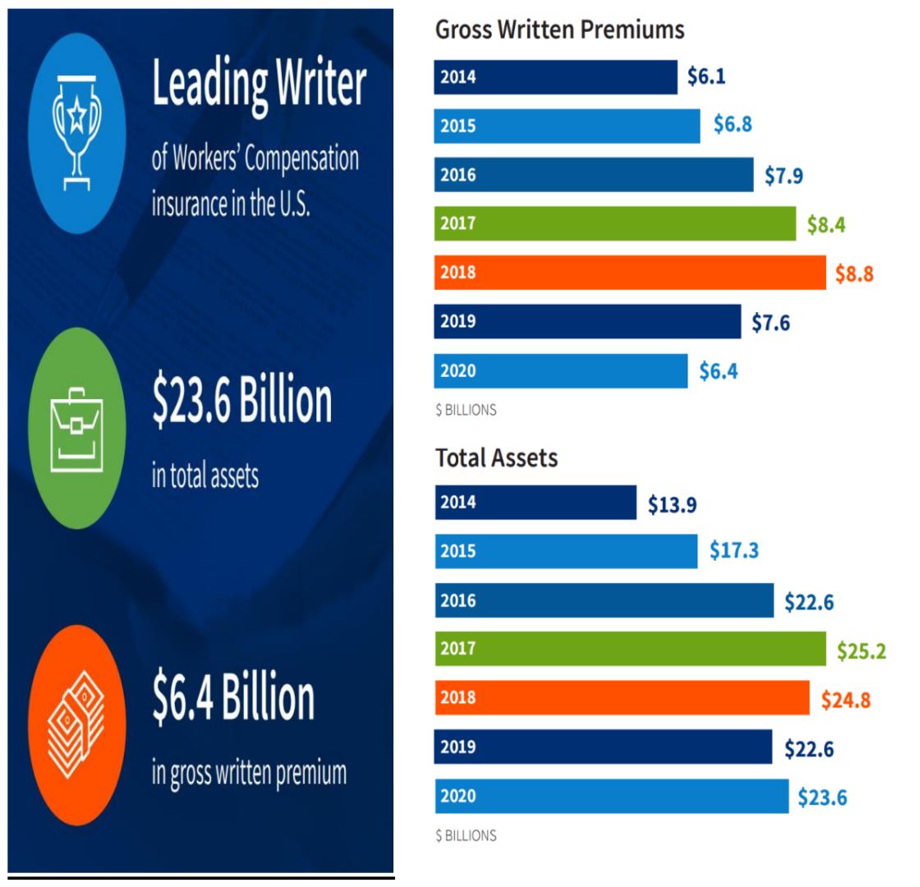
Primary Line of Business
“We are a leading writer of workers' compensation insurance in the United States, with a focus on small to mid-sized employers primarily in low to medium hazard industry groups,.., Our Warranty Solutions segment is a leading provider of extended service and warranty coverage for consumer and commercial goods and vehicles”
Notes:
First, AmTrust’s bread and butter is Worker’s Compensation. The company's workers' compensation insurance provides coverage for workplace injuries and illnesses – and is available in all 50 states in the U.S. AmTrust's extended warranty coverage protects consumers from the cost of replacement or repair of vehicles, appliances, and other consumer goods and is designed to help its customers maintain profitability and build customer loyalty.

Slide 4
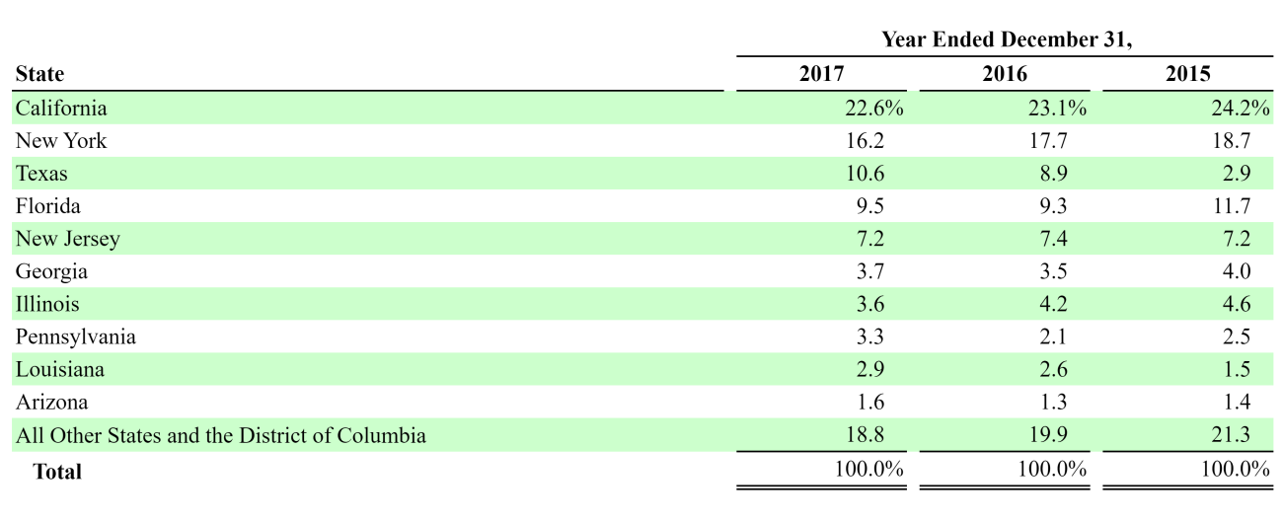
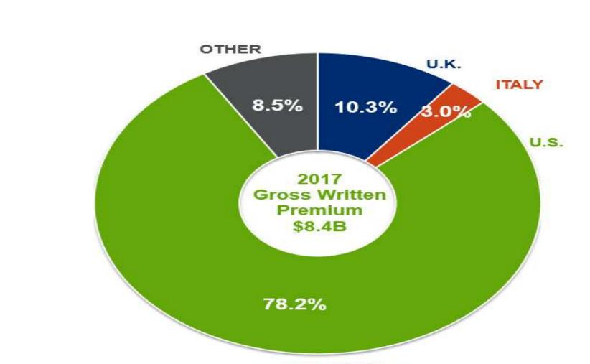
Geographic Distribution
AmTrust’s Operations Diversification Profile
Investor Presentation AmTrust Financial Services, Inc. – May 2018
Notes:
Their geographic diversification could be better, which means risk is rather high from that perspective – but the insurance industry is non-cyclical, and the U.S commercial market is very strong, especially for workers compensation.

Slide 5
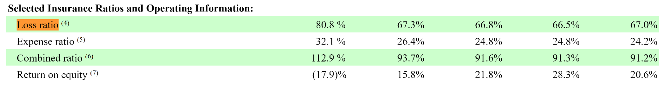
Operational Risk Profile
Small Commercial Business Segment — Results of Operations
→ AmTrust’s primary motive behind underwriting policy is to win market share
AmTrust Financial Services, Inc. 10K Filing with the SEC, 2017
Notes:
According to the 10-K report, AmTrust Financial Services, Inc.’s loss ratio was .808 – suggesting that the company was writing aggressive premiums to win market share: especially considering their expense ratio of .321; which suggests that they were investing heavily into their operations – which coincides with a prospectively aggressive business strategy.

Slide 6
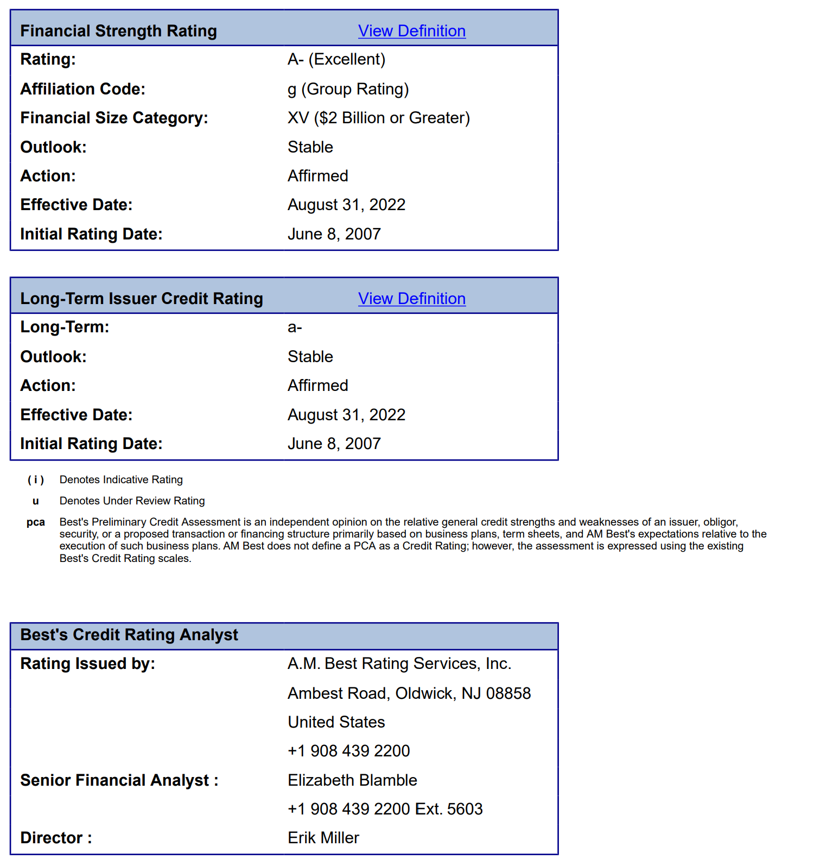

Company Credit Risk Profile
The ratings reflect the company's strong balance sheet strength, favorable operating performance, and diversified business profile, as well as its experienced management team and effective risk management practices.
Notes:
And AmTrust is a fairly trustworthy company. They are aggressive in their underwriting policy but have been an industry leader in workers compensation – and they have strong financial hygiene as well as risk management.

Slide 7
Invested Asset Portfolio
CMO
Pass-Through
Municipal
ABS
CMBS
Equity
UST
Sovereign-Debt (US territories only)
Corporate
Notes:
Now for the company’s Investment Activity. According to the subsidiary holding portfolio I’ve compiled, it is valued at $5.8B and primarily consists of fixed maturity securities, which are generally investment-grade securities issued by corporations, governments, or government agencies. The company's investment strategy is focused on generating consistent, long-term investment returns while maintaining a high degree of liquidity and minimizing credit risk. Overall, AmTrust Financial Services, Inc. maintains a well-diversified portfolio of invested assets that is designed to generate consistent, long-term investment returns while minimizing risk. With less than 4% of it’s invested assets having a credit quality being lower than B, AmTrust’s risk-averse portfolio is well-aligned with its aggressive operational risk profile.

Slide 8
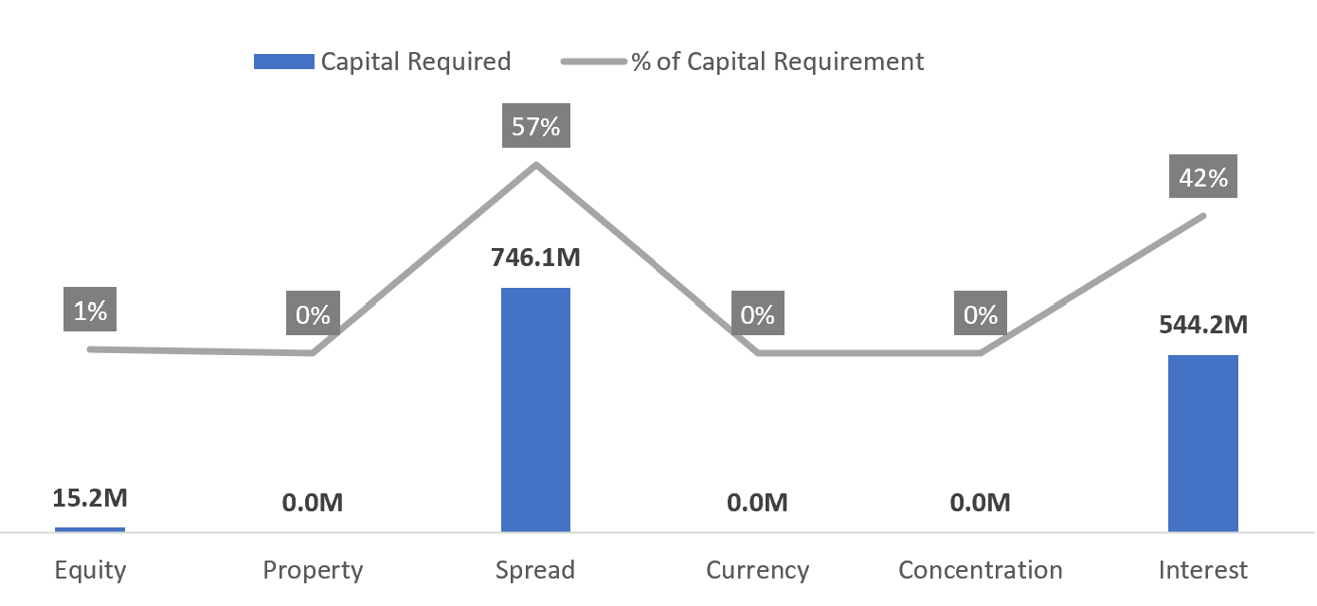
SCR Capital Requirement
Notes:
Overall, the risk profile of AmTrust’s Portfolio of Invested assets in fairly risk averse – which coincides with their risk seeking underwriting policy. The majority of their risk is dependent on interest rate fluctuations and company credit. Since over 95% of their assets have a credit rating of B or better, it’s unlikely that the spread risk assumed will impact AmTrust in a catastrophic manner. The SCR capital requirement should be definitely enough for AmTrust to remain solvent.

Slide 9
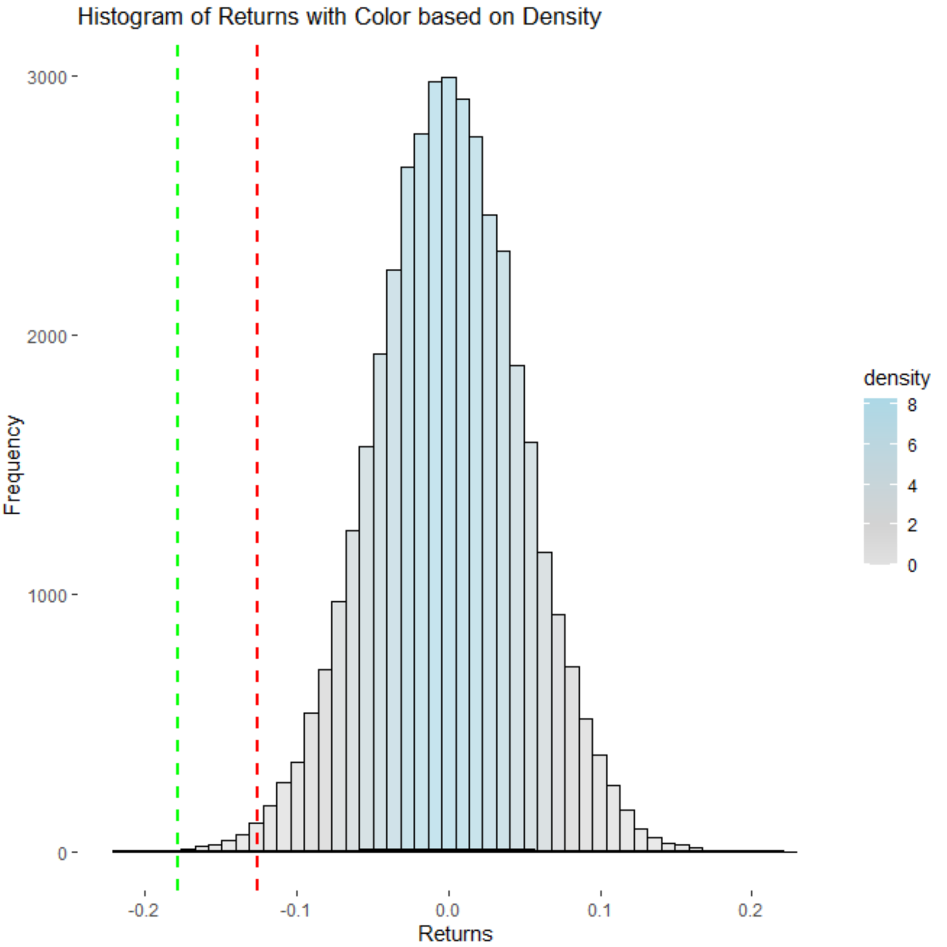
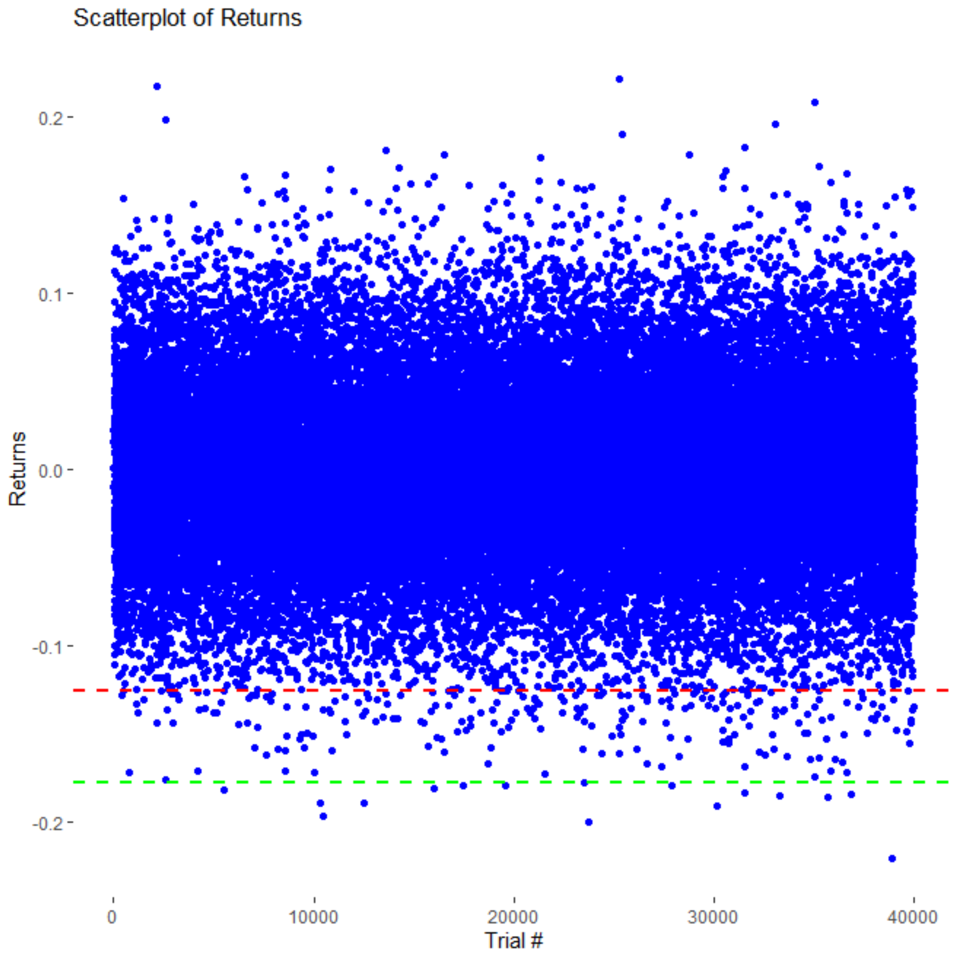
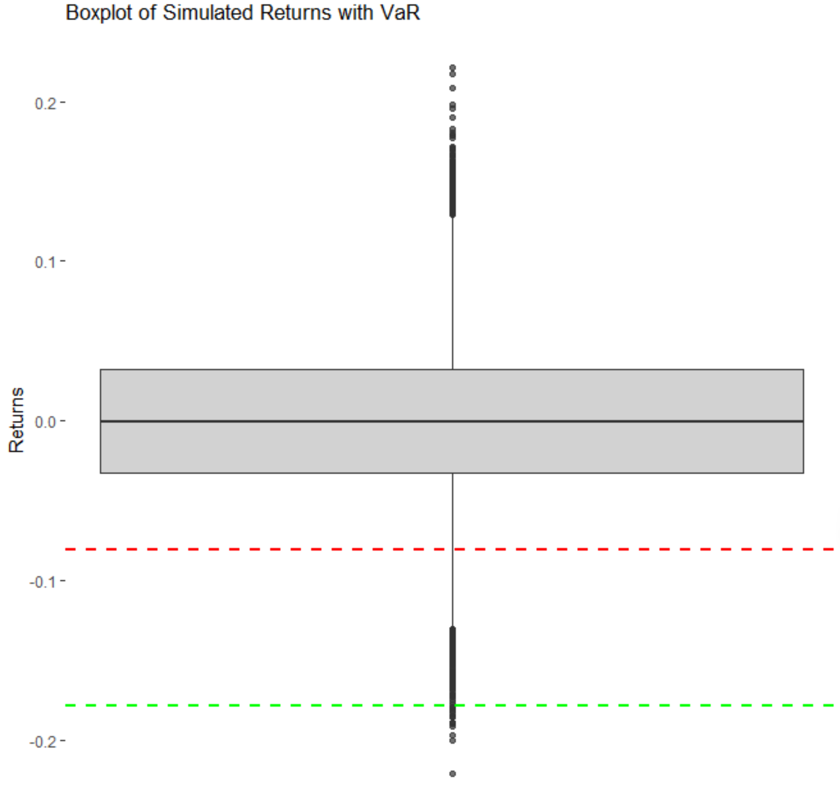
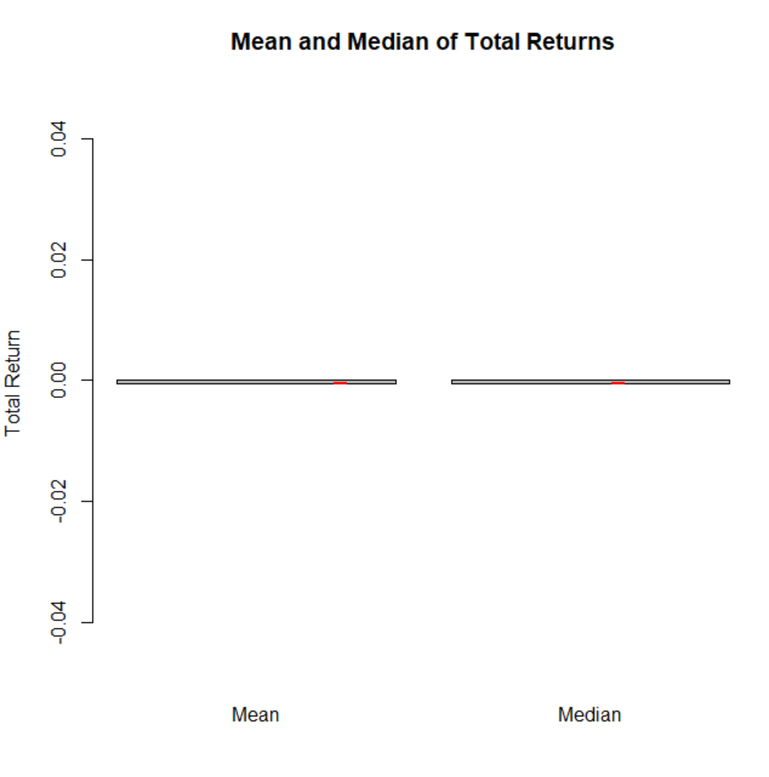
Scenario Analysis
Min | SCR | VaR | 1st Quantile | Median | Mean | 3rd Quantile | Max
-22.1% | -17.8% | -12.6% | -3.3% | 0.1% | 0.1% | 3.2% | 22.2%
Return Distribution
Precision
The returns observed follow an approximate normal distribution, centered at 0 – indicating a realistic simulation returns were positive more often than negative; suggesting that the realized portfolio return is less likely to be negative
The positive returns observed also mirror negative returns slightly – with most returns distributed around the center; suggesting that the portfolio is well diversified, and that the economic environment of the simulation was fairly conservative
The symmetrical nature of the box plot of observed returns furthermore suggests that the simulation data is not skewed
Given the range of plots, it also observed that the simulated worst-case scenario is not far off from the simulated VaR – which is just about 5% above the SCR capital requirement
The box plot also shows that 75% of the returns are slight losses or better
SCR Capital Required
VaR
SCR Capital Required
VaR
The area of returns above the red and green lines represent the observed events for AmTrust’s capital reserved under SCR vs the simulated VaR remains solvent; here we can see the both cover the vast majority of losses
Below, we see the mean and median values compared against each other together with their respective error bars; not only is the mean virtually equivalent to the median – indicating that the average simulated return is the same as the most common typical return, with neglible error bars
SCR Capital Required
VaR
Notes:
The simulated returns performed as expected – the returns were normally distributed across each trial (quarterly timesteps), with most returns being with 3% of 0. The distribution was mostly symmetrical, with the average and median returns being the same, and a variance of just under 5% (4.888%) – which resulted standard error being virtually 0. The VaR was 12.6%, which was just shy of 5% under my SCR capital requirement. I thought that these results indicated a realistic simulation, especially considering that the Moody’s economic environmental factors are fairly relaxed in comparison to that of Solvency II.

